Slide 1
RSNA 2022 Cervical Spine Fracture Detection

Slide 2

Problem Overview
Identify cervical fractures from scans
The goal of this competition is to identify fractures in CT scans of the cervical spine (neck) at both the level of a single vertebrae and the entire patient.
Notes:
Over 1.5 million spine fractures occur annually in the United States alone resulting in over 17,730 spinal cord injuries annually. The most common site of spine fracture is the cervical spine. There has been a rise in the incidence of spinal fractures in the elderly and in this population, fractures can be more difficult to detect on imaging due to superimposed degenerative disease and osteoporosis. Imaging diagnosis of adult spine fractures is now almost exclusively performed with computed tomography (CT) instead of radiographs (x-rays). Quickly detecting and determining the location of any vertebral fractures is essential to prevent neurologic deterioration and paralysis after trauma.

Slide 3
What is the “Cervical” region of our Vertebrae?

Slide 4
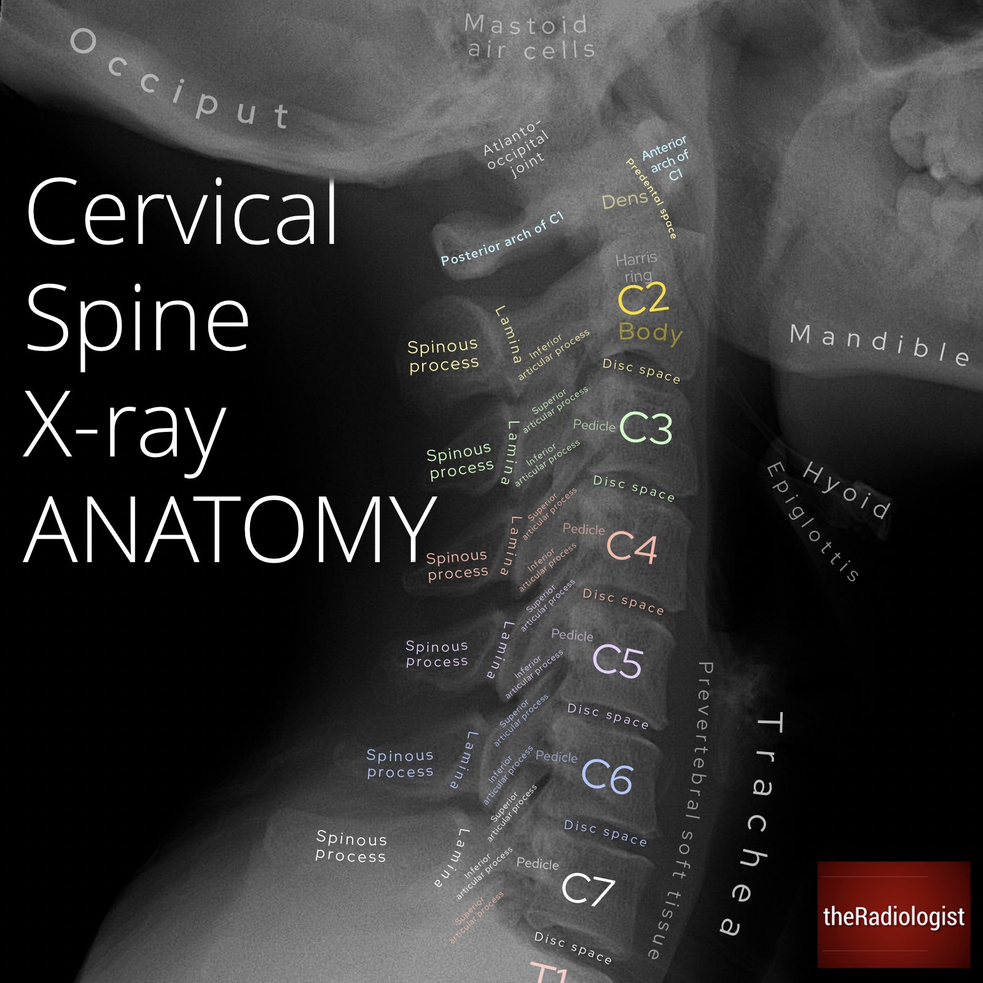

Slide 6
But what do the CT Scans look like?

Slide 7
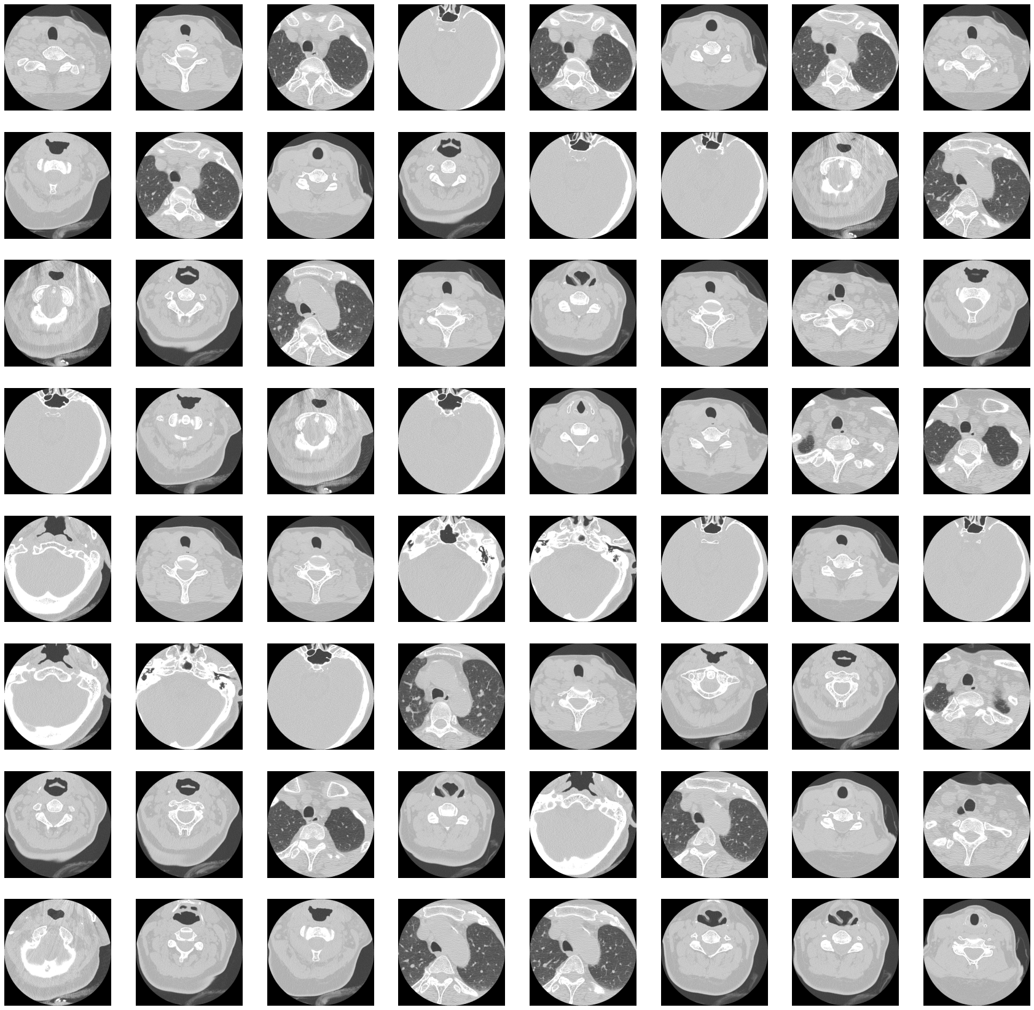

Slide 8
DICOM File Format

Slide 9
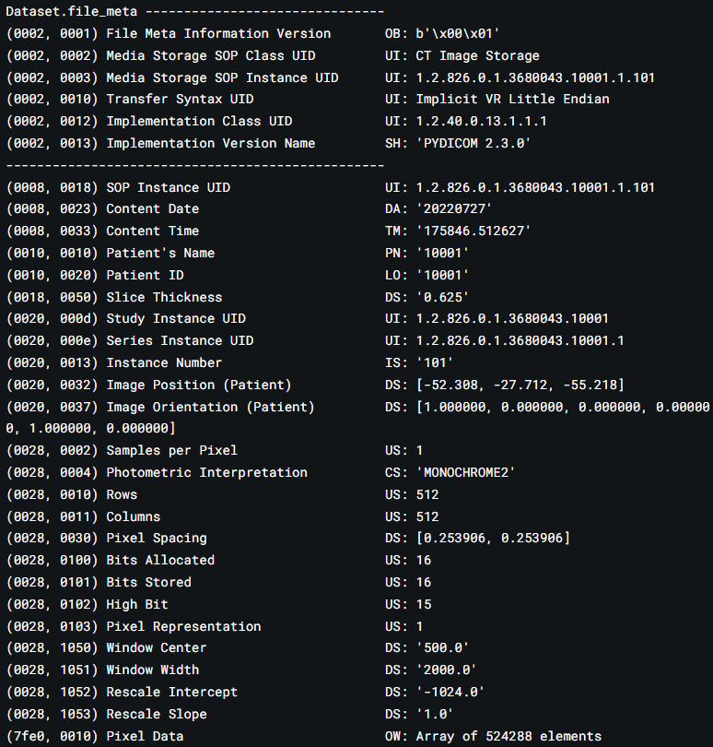
HEADER
IMAGE
Notes:
A DICOM file consists of a header and image data sets packed into a single file. The information within the header is organized as a constant and standardized series of tags. By extracting data from these tags one can access important information regarding the patient demographics, study parameters, etc.
The image data is stored in an array under 'Pixel Data'. Everything else is metadata.
The 'Rows' and 'Columns' values tell us the image size.
The 'Pixel Spacing' and 'Slice Thickness' tell us the pixel size and thickness.
The 'Window Center' and 'Window Width' give information about the brightness and contrast of the image respectively.
The 'Rescale Intercept' and 'Rescale Slope' determine the range of pixel values. (ref).
'ImagePositionPatient' tells us the x, y, and z coordinates of the top left corner of each image in mm
InstanceNumber is the slice number.

Slide 10
Baseline Solution

Slide 11
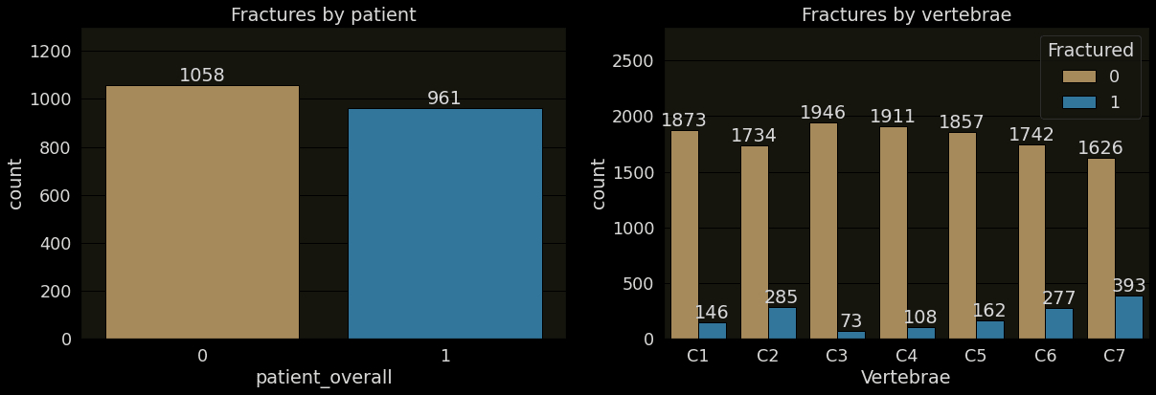
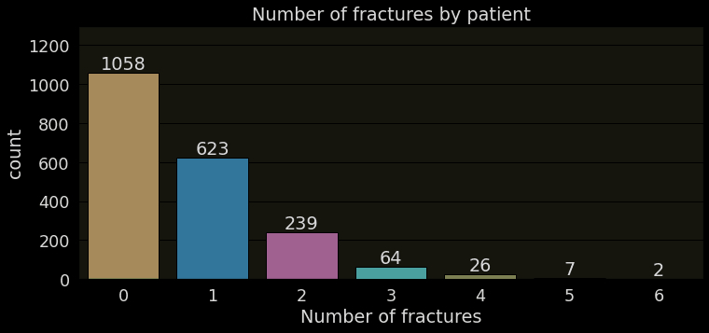

Slide 12
BASELINE = Only trying to predict whether a patient has a fracture (1) or not (0)

Slide 13
Transfer Learning
Treating each CT Scan as an IMAGE, but instead of 3 RGB Channels, the number of channels equals the number of slices/scans for that patient.
But here we run into a problem. The height of each scan varies from patient to patient, i.e. the number of slices for each patient varies.
We need a constant channel input for using CNN Architectures

Slide 14
Minimum number of scans for a patient = 300
Maximum number of scans for a patient = 1082
Sample N scans for each patient at equally spaced intervals. Thus making the input channel size CONSTANT
Now we can use any 2D-CNN architecture with in_channels = N

Slide 15
Using the mobilenetv3_large_100 architecture
Changing the input layers to take 69/300 channels.
Changing the output layer for binary classification.
Freezing the intermediate layers for training.

Slide 16
Setting the value of N as 69 and 300
Validation Accuracy (N=69) = 50%
Validation Accuracy (N=300) = 57 %
All values after 10 epochs

Slide 17
Further Improvements
Using 3D-CNN Architectures.
01
Using sequential models (prevent information loss).
02
Using segmentation data to isolate individual vertebrae for prediction.
03

Slide 18
Thank You
Amey Rambatla
190106011

